Slide 1

Tutorial On How To Use Huddle Up

Slide 2
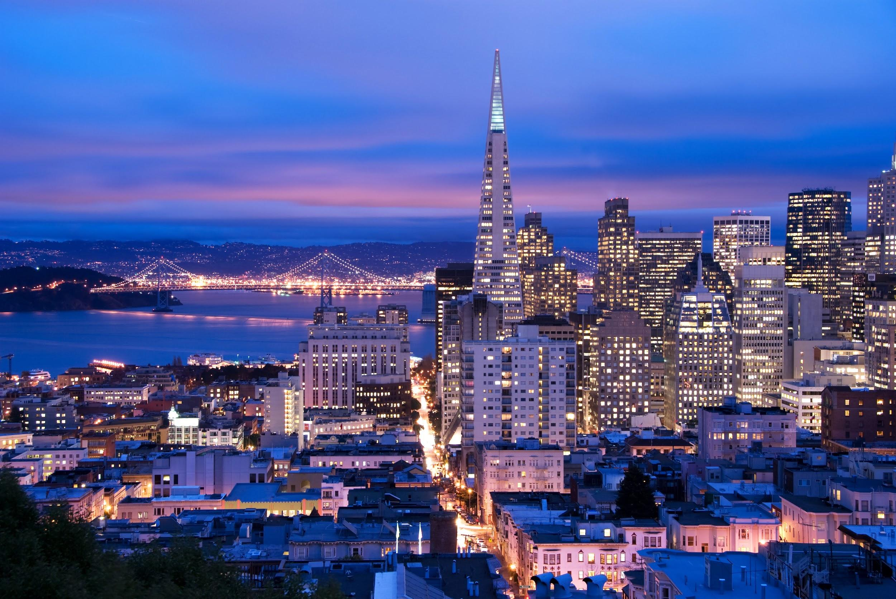
First Step
Log into your Huddle up account to get access to more of the website.

Slide 3

Second Step
On our Home page there will be a calendar provide for you to mark the days that you are busy so we can set an arranged date for your plans .
(On our next slide is a picture of our calendar)

Slide 4
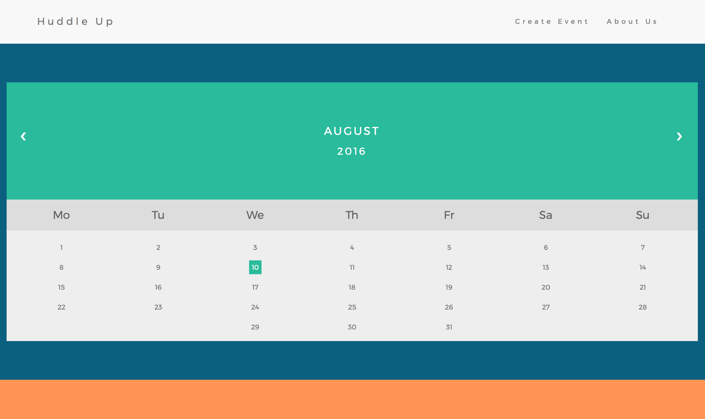

Slide 5

Third Step
After you have filled in all the information on the Home Page , move on to the next page which is under Create Event and on this page name the event you're planning to attend and from there we will give you a list of multiple direction from your destination to the destination you want to attend with the help of google maps in addition it will give you departer time to make sure you get to where you want to go on time.

Slide 6
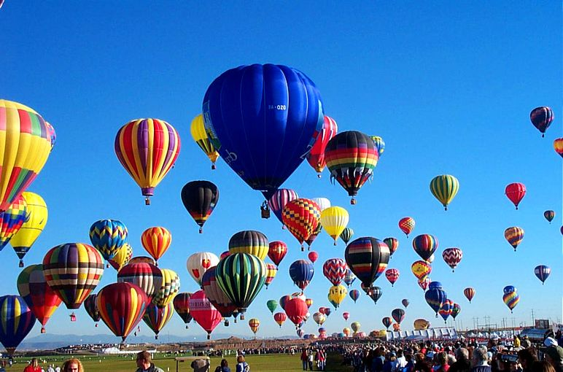
Fourth Step
Share the event with the people you want to attend with you , And from there you well set the meeting place up that you want to go to and we well link you and your friends to the event

